Slide 1
Motion Detection by Eigen-projections from
Incremental Subspace Learning
Optical Flow
Motion
Detection [1]
Temporal/Frame Difference
Single Gaussian (SG).
Single General Gaussian (SGG).
Mixture of Gaussians (MOG).
Mixture of General Gaussians (MOGG).
Kernel Density Estimation (KDE).
Basic Background Modeling (Gaussian Models)
Background subtraction [2]
Statistical Background Modeling (Support Vector Machine)
Support Vector Machine (SVM).
Support Vector Regression (SVR).
Support Vector Data Description (SVDD).
Fuzzy Background Modeling (Subspace Learning Models)
Principal Components Analysis (SL-PCA).
Independent Component Analysis (SL-ICA).
Incremental Non Negative Matrix Factorization (SL-INMF).
Incremental Rank-(R1,R2,R3) Tensor (SL-IRT).
[1] T. Bouwmans, “Traditional and recent approaches in background modeling for foreground detection: An overview”. Computer Science Review, Vol 11, No. 1, pp. 31–66, 2014.
[2] T. Bouwmans, “Subspace learning for background modeling: A survey”, Recent Patents on Computer Science, Vol. 2 No. 3, pp. 223–234, 2009.
1

Slide 2
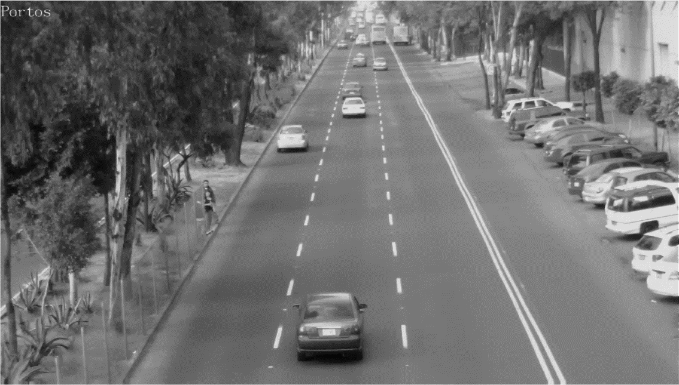
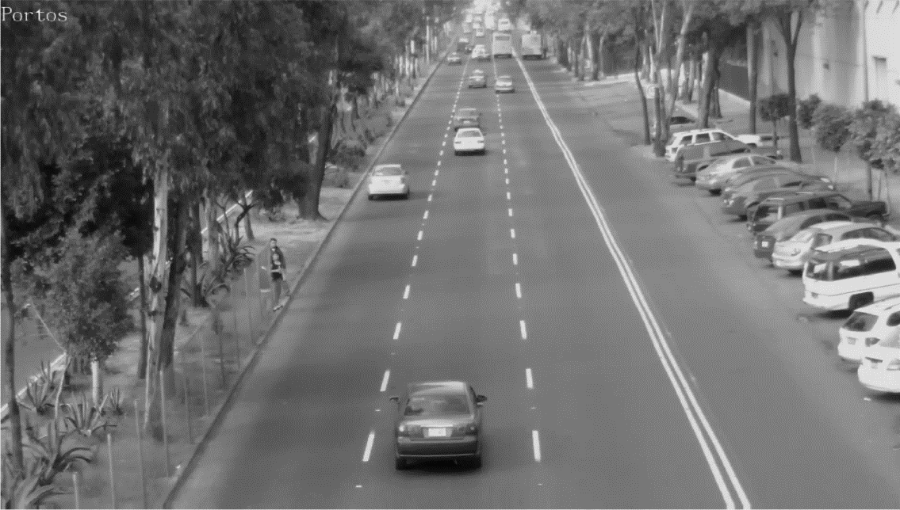

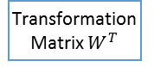
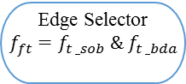

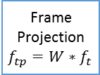


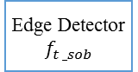
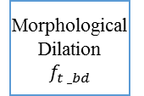
Block Update${ f}_{t },f_{t −1}$
Video
Sequence
Block Update $f_{t },f_{t −1}$
Edge Detector
$$f_{t _sob}$$
IPCA
Transformation Matrix $W^{T}$
Edge Selector
$${f_{ft}=f}_{t _sob} \& f_{t _bda}$$
Frame Projection $f_{tp}=W∗f_{t }$
Area Thresholding
Previous Frame $f_{t −1}$
Current Frame $f_{t }$
Thresholding
& Binarization
Morphological Dilation
$$f_{t _bd}$$
2

Slide 3
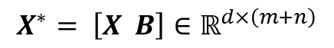



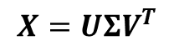


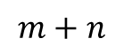


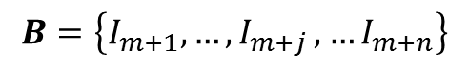
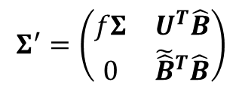
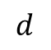
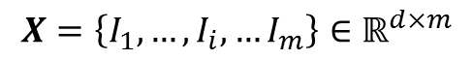


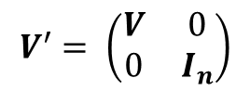

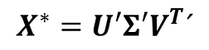

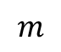
Incremental Principal Component Analysis (IPCA)
$$m$$
$$X$$
$$U$$
$$Σ$$
$$V^{T}$$
$$X=\left\{I_{1},…,I_{i},…I_{m}\right\}∈ℝ^{d×m}$$
$$d$$
$$X=UΣV^{T}$$
$$B=\left\{I_{m+1},…{,I}_{m+j},…I_{m+n}\right\}$$
$$m+n$$
$$X^{∗}= \left[X B\right]∈ℝ^{d×\left(m+n\right)}$$
$$X$$
$$B$$
$$U^{′}$$
$$Σ^{′}$$
$$V^{′T}$$
$$V^{′}= \left(\begin{matrix}V & 0 \\ 0 & I_{n}\end{matrix}\right)$$
$$d$$
$$X^{∗}=U′Σ′V^{T}´$$
$$Σ^{′}=\left(\begin{matrix}fΣ & U^{T}\hat{B} \\ 0 & {\tilde{\hat{B}}}^{T}\hat{B}\end{matrix}\right)$$
$$U^{′}=\left(U \tilde{B}\right)$$
[3] A. Levy and M. Lindenbaum, “Sequential Karhunen-Loeve basis extraction and its application to images”. IEEE Transactions on Image Processing, Vol. 9, No. 8, pp. 1371–1374, 2000.
[4] J. Lim, D. Ross, R. Lin, and M. Yang, “Incremental Learning for Visual Tracking”, Neural Information Processing Systems, pp. 793–800, 2004.
3

Slide 4
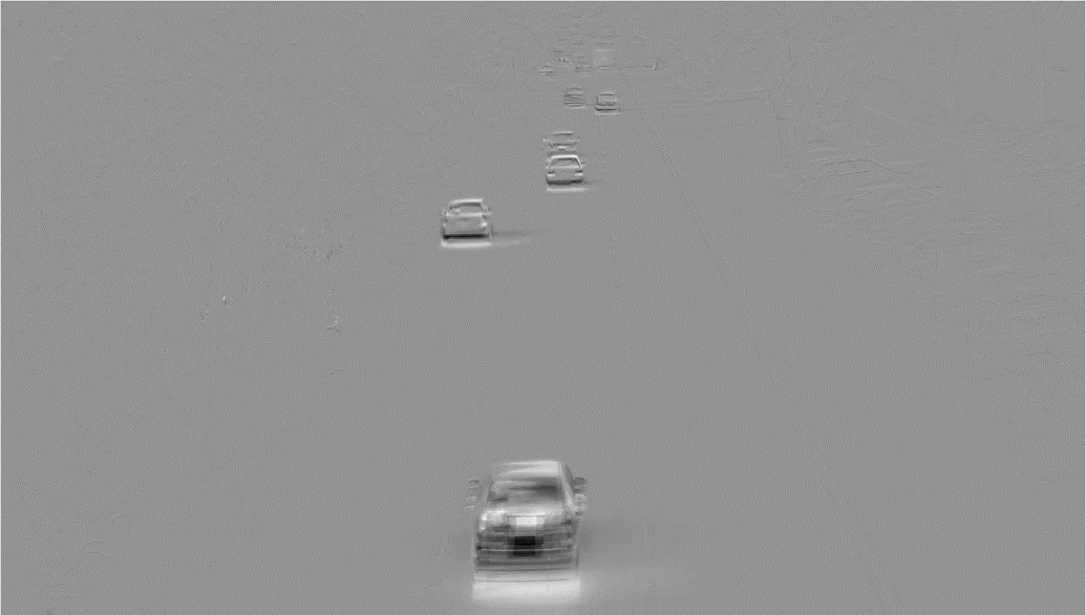

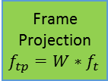



F$rame Projection { f}_{tp }=W∗f_{t}$
Video
Sequence
Block Update $f_{t },f_{t −1}$
Edge Detector
$$f_{t _sob}$$
IPCA
Transformation Matrix $W^{T}$
Edge Selector
$${f_{ft}=f}_{t _sob} \& f_{t _bda}$$
Frame Projection $f_{tp}=W∗f_{t }$
Area Thresholding
Curret Frame $f_{t }$
Current Frame $f_{t }$ projected by the main eigenvector from IPCA
Thresholding
& Binarization
Morphological Dilation
$$f_{t _bd}$$
4

Slide 5
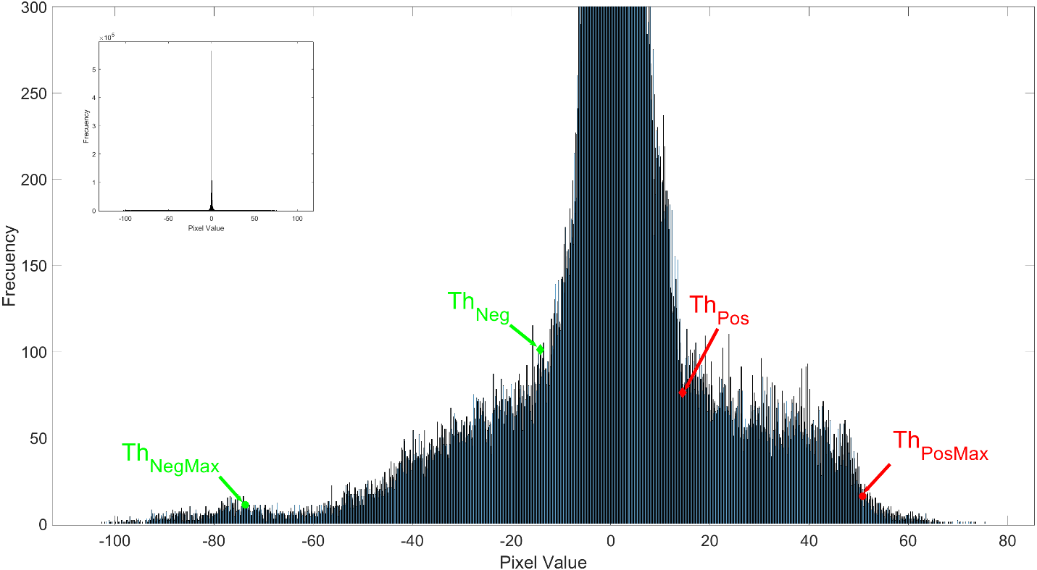
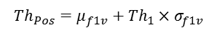
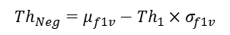
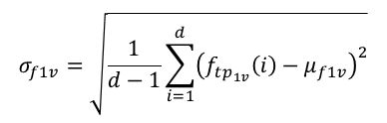
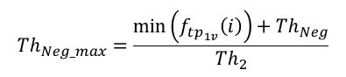
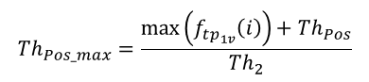
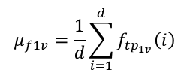
Thresholding & Binarization
Video
Sequence
$$μ_{f1v}=\frac{1}{d}\sum_{i=1}^{d}{f_{tp_{1v}}\left(i\right)}$$
Block Update $f_{t },f_{t −1}$
Edge Detector
$$f_{t _sob}$$
$$σ_{f1v}=\sqrt{\frac{1}{d−1}\sum_{i=1}^{d}{{\left(f_{tp_{1v}}\left(i\right)−μ_{f1v}\right)}^{2}}}$$
IPCA
Transformation Matrix $W^{T}$
Edge Selector
$${f_{ft}=f}_{t _sob} \& f_{t _bda}$$
$${Th}_{Neg}=μ_{f1v}−{Th}_{1}×σ_{f1v}$$
$${Th}_{Pos}=μ_{f1v}+{Th}_{1}×σ_{f1v}$$
Frame Projection $f_{tp}=W∗f_{t }$
$${Th}_{Pos_max}=\frac{max\left(f_{tp_{1v}}\left(i\right)\right)+{Th}_{Pos}}{{Th}_{2}}$$
Area Thresholding
Threshold dynamics based on the statistic parameters of the projected frame.
$${Th}_{Neg_max}=\frac{min\left(f_{tp_{1v}}\left(i\right)\right)+{Th}_{Neg}}{{Th}_{2}}$$
Thresholding
& Binarization
Morphological Dilation
$$f_{t _bd}$$
5

Slide 6
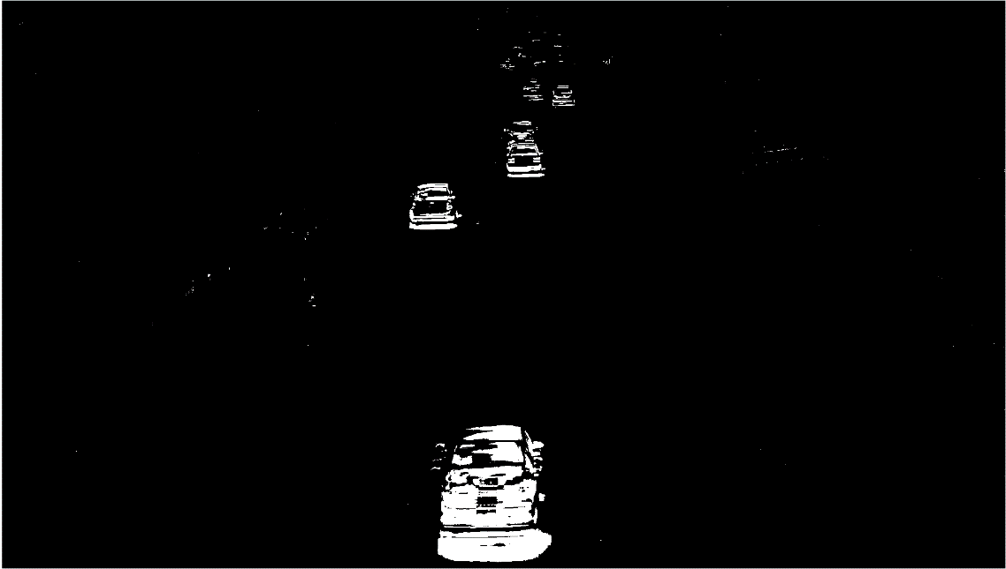
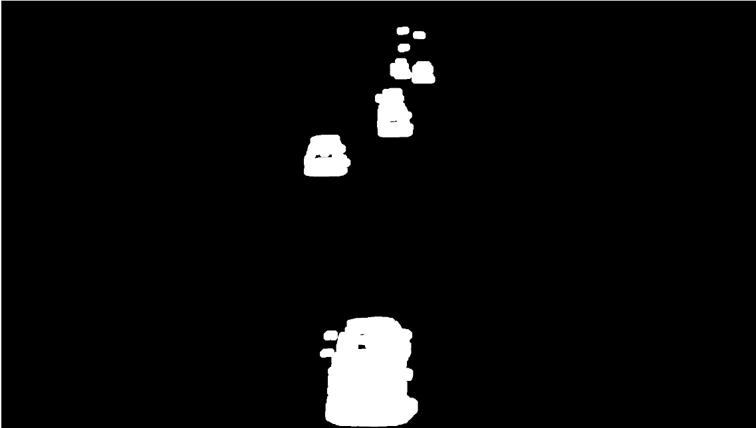
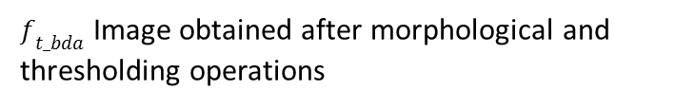
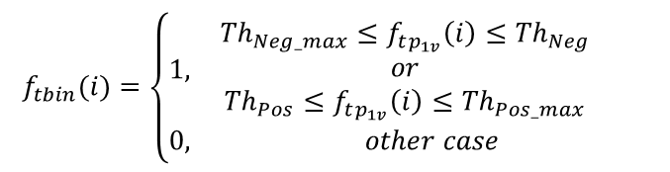
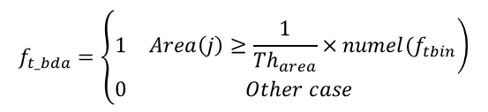
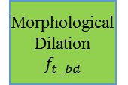
Morphological Dilation
& Area Thresholding
Video
Sequence
Block Update $f_{t },f_{t −1}$
Edge Detector
$$f_{t _sob}$$
IPCA
Transformation Matrix $W^{T}$
Edge Selector
$${f_{ft}=f}_{t _sob} \& f_{t _bda}$$
Frame Projection $f_{tp}=W∗f_{t }$
Area Thresholding
Binarized image
$f_{t_bda}$ Image obtained after morphological and thresholding operations
$$f_{tbin}(i)=\left\{\begin{aligned}&\begin{matrix}1, & \begin{matrix}{{Th}_{Neg_max}≤f}_{tp_{1v}}\left(i\right)≤{Th}_{Neg} \\ or \\ {{Th}_{Pos}≤f}_{tp_{1v}}\left(i\right)≤{Th}_{Pos_max}\end{matrix}\end{matrix} \\ &0, other case \end{aligned}\right.$$
Thresholding
& Binarization
Morphological Dilation
$$f_{t _bd}$$
$$f_{t_bda}=\left\{\begin{aligned}&\begin{matrix}1 & \left.Area\left(j\right)≥\frac{1}{{Th}_{area}}×numel(f_{tbin}\right)\end{matrix} \\ &\begin{matrix}0 & Other case\end{matrix}\end{aligned}\right.$$
6

Slide 7
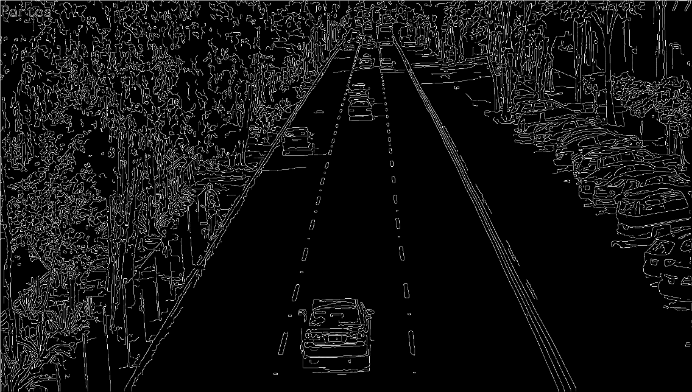
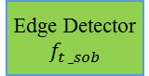
Thresholding & Binarization
Video
Sequence
Block Update $f_{t },f_{t −1}$
Edge Detector
$$f_{t _sob}$$
IPCA
Transformation Matrix $W^{T}$
Edge Selector
$${f_{ft}=f}_{t _sob} \& f_{t _bda}$$
Frame Projection $f_{tp}=W∗f_{t }$
Area Thresholding
Current Frame $f_{t }$in gray levels
Edge detection using Sobel algorithm in the current frame in gray levels
Thresholding
& Binarization
Morphological Dilation
$$f_{t _bd}$$
7

Slide 8
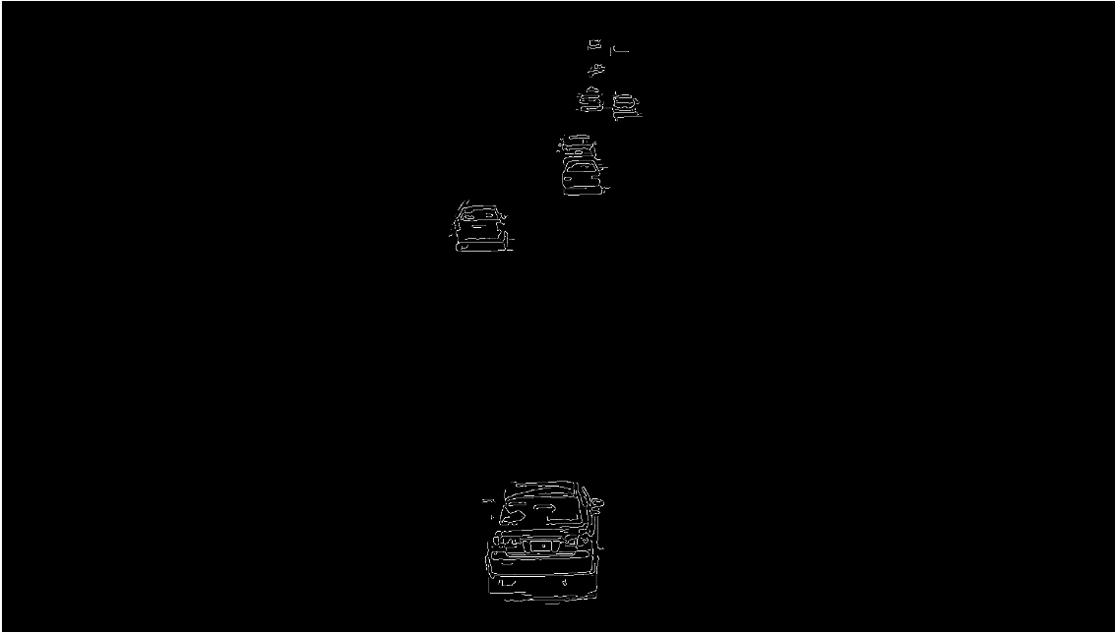
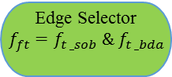
Thresholding & Binarization
Video
Sequence
Block Update $f_{t },f_{t −1}$
Edge Detector
$$f_{t _sob}$$
IPCA
Transformation Matrix $W^{T}$
Edge Selector
$${f_{ft}=f}_{t _sob} \& f_{t _bda}$$
Frame Projection $f_{tp}=W∗f_{t }$
Area Thresholding
Edge detection using Sobel algorithm in the current frame in gray levels
Moving objects obtained using the proposed scheme (five of the six moving objects was detected).
Thresholding
& Binarization
Morphological Dilation
$$f_{t _bd}$$
8

Slide 9
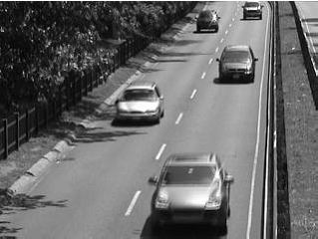
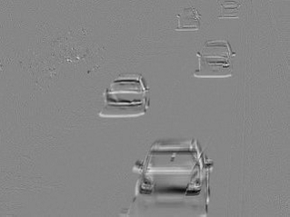
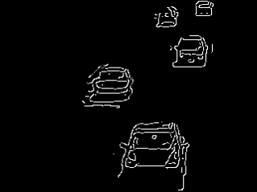
Examples, Changedetection.net: Highway
a) in gray scale; b) projected image; c) final edge selector
Highway Frame 1070
9

Slide 10
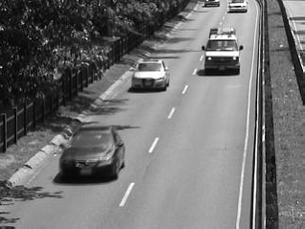
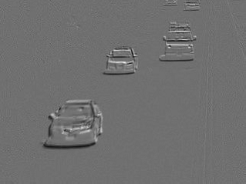
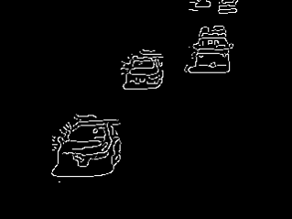
Examples, Changedetection.net: Highway
a) in gray scale; b) projected image; c) final edge selector
Highway Frame 1470
10

Slide 11
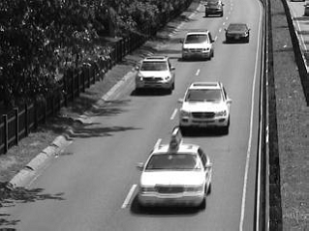
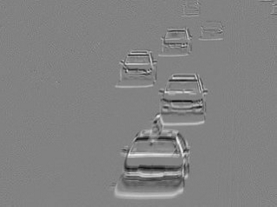
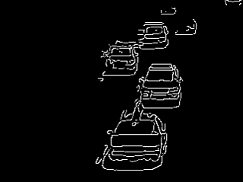
Examples, Changedetection.net: Highway
a) in gray scale; b) projected image; c) final edge selector
Highway Frame 1640
11

Slide 12
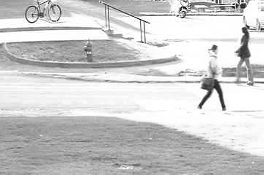
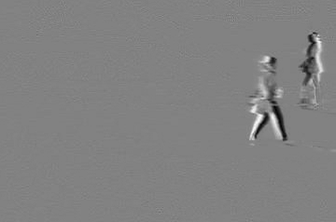

Examples
Examples, Changedetection.net: Pedestrian
a) in gray scale; b) projected image; c) final edge selector
Pedestrian Frame 421
12

Slide 13
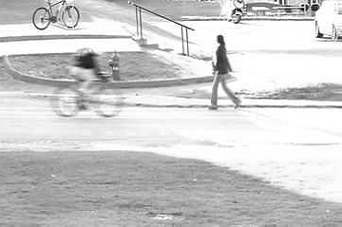
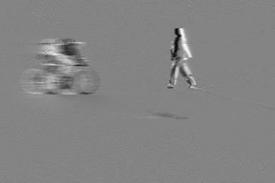
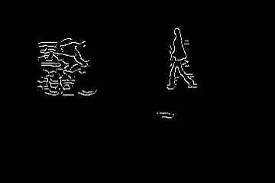
Examples, Changedetection.net: Pedestrian
a) in gray scale; b) projected image; c) final edge selector
Pedestrian Frame 473
13

Slide 14



Examples, Changedetection.net: Pedestrian
a) in gray scale; b) projected image; c) final edge selector
Pedestrian Frame 969
14

Slide 15



Examples, Changedetection.net: PETS2006
a) in gray scale; b) projected image; c) final edge selector
PETS2006 Frame 117
15

Slide 16



Examples, Changedetection.net: PETS2006
a) in gray scale; b) projected image; c) final edge selector
PETS2006 Frame 195
16

Slide 17



Examples, Changedetection.net: PETS2006
a) in gray scale; b) projected image; c) final edge selector
PETS2006 Frame 1167
17

Slide 18
Examples, Main road 3, CDMX Mexico City
18

